Slide 1
CS 61A: Tree Recursion
Nipun Ramakrishnan | nipun.ramk@berkeley.edu
Jessica Yeh | jessicayeh@berkeley.edu

Slide 2
Recursion
Base Case
The smallest input. Given this input, you would automatically know the answer!
Recursive Case
How can you reduce the problem so the input gradually becomes closer to the base case? How should we use the result of this reduced problem in the final output?
Recursive leap of faith!

Slide 3
Tree Recursion
Tree Recursion is like regular recursion, but involves 2 or more recursive calls!
Common tree recursion problems:
Explore the best of two or more possible options
Count the total number of ways to achieve something
Tips for solving tree recursion problems:
At each recursive step, think about what options you have to continue solving the problem
Each option should have its own recursive call!
Think about how to combine your recursive calls
Eg: sum, max, min

Slide 4
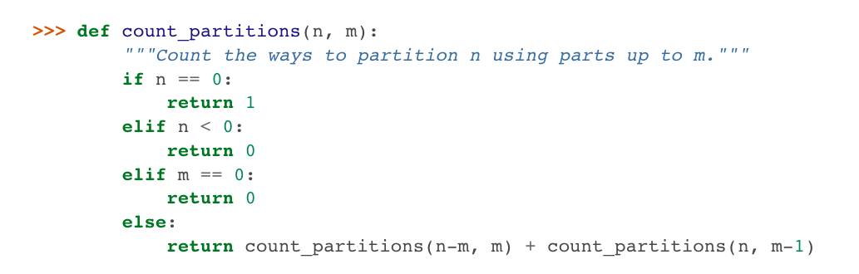
Example: count_partitions
Option 1: Use the largest part M
Option 2: Don’t use the largest part M

Slide 5
Practice Problems
Printable worksheet

Slide 6
def sum_largest(n, k):
"""Given non-negative integers n, k, return the sum of the k largest digits of n. >>> sum_largest(2018, 2) # 2 and 8 are the two largest digits (larger than 0 and 1). 10 >>> sum_largest(12345, 10) # There are only five digits, so all are included in the sum. 15 """ if________________________: return 0 a = ______________________
b = ______________________ return ______________(a, b)

Slide 7
def sum_largest(n, k):
"""Given non-negative integers n, k, return the sum of the k largest digits of n. >>> sum_largest(2018, 2) # 2 and 8 are the two largest digits (larger than 0 and 1). 10 >>> sum_largest(12345, 10) # There are only five digits, so all are included in the sum. 15 """ if ____n == 0 or k == 0____: return 0 a = ____n % 10 + sum_largest(n // 10, k-1)_____
b = ____sum_largest(n // 10, k)________________ return _____max_____(a, b)

Slide 8
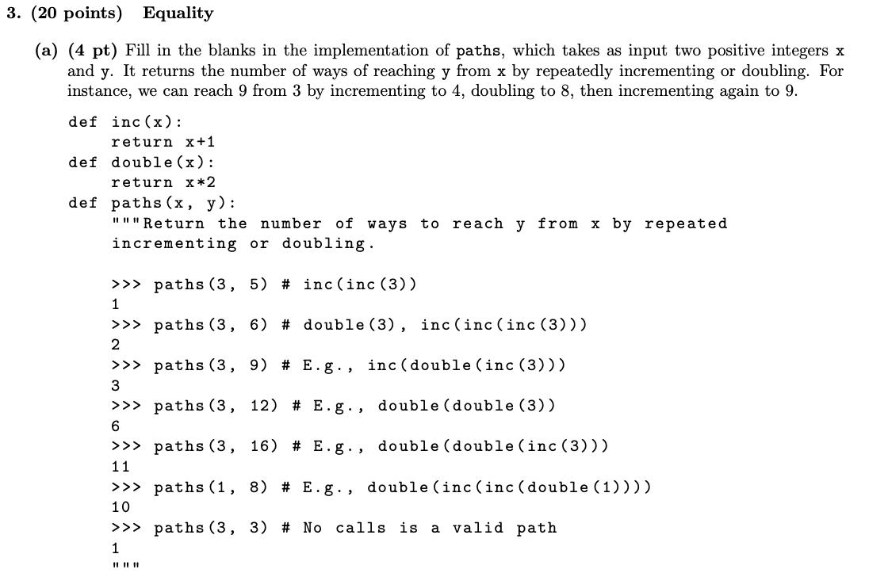
Spring 2013 Final Q3A

Slide 9
def inc(x):
return x +1
def double(x):
return x*2
def paths(x, y):
“”” Return the number of ways to reach y from x by repeated incrementing or doubling . “””
if x > y:
return _____________________________
elif x == y:
return _____________________________
else:
return _____________________________

Slide 10
def inc(x):
return x +1
def double(x):
return x*2
def paths(x, y):
“”” Return the number of ways to reach y from x by repeated incrementing or doubling . “””
if x > y:
return _______0______________________
elif x == y:
return _______1______________________
else:
return paths(inc(x),y) + paths(double(x),y)

Slide 11
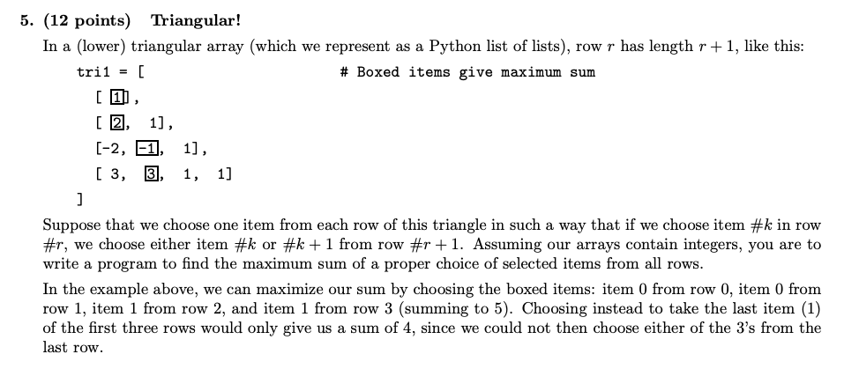
Spring 2016 Final Q5A

Slide 12
def triangle_sum(tri):
""" Given that tri is a triangular array , return the maximum sum attainable by selecting one item from each row , where if item #k is selected from row #r , either item #k or item #k +1 is selected from row #r +1. """
rows = len( tri )
def partial_sum(r , k ):
""" The maximum partial sum of items from rows #R , R +1 , ... starting from selecting item #K in row #R . """
if ______________________________ :
return ___________________________________________
else :
return ___________________________________________
return partial_sum( ____________________________________ )

Slide 13
def triangle_sum(tri):
""" Given that tri is a triangular array , return the maximum sum attainable by selecting one item from each row , where if item #k is selected from row #r , either item #k or item #k +1 is selected from row #r +1. """
rows = len( tri )
def partial_sum(r , k ):
""" The maximum partial sum of items from rows #R , R +1 , ... starting from selecting item #K in row #R . """
if ________r > = rows______________________ :
return __________0_________________________________
else :
return ___tri[r][k] + max(partial_sum(r+1, k), partial_sum(r+1, k+1)____
return partial_sum( ________0, 0_______________________ )

Slide 14
Spring 2018 Final Q5B
Implement factorize, which takes two integers n and k, both larger than 1. It returns the number of ways that n can be expressed as a product of non-decreasing integers greater than or equal to k.
def factorize(n, k=2):
""" Return the number of ways to factorize positive integer n.
>>> factorize(7) # 7
1
>>> factorize(12) # 2*2*3, 2*6, 3*4, 12
4
>>> factorize(36)
# 2*2*3*3, 2*2*9, 2*3*6, 2*18, 3*3*4, 3*12, 4*9, 6*6, 36 9 """
if _____________________________________________________________________________________:
return 1
elif ___________________________________________________________________________________:
return 0
elif ___________________________________________________________________________________:
return factorize(_________________________________, ________________________________)
return _________________________________________________________________________________

Slide 15
Spring 2018 Final Q5B
Implement factorize, which takes two integers n and k, both larger than 1. It returns the number of ways that n can be expressed as a product of non-decreasing integers greater than or equal to k.
def factorize(n, k=2):
""" Return the number of ways to factorize positive integer n.
>>> factorize(7) # 7
1
>>> factorize(12) # 2*2*3, 2*6, 3*4, 12
4
>>> factorize(36)
# 2*2*3*3, 2*2*9, 2*3*6, 2*18, 3*3*4, 3*12, 4*9, 6*6, 36 9 """
if ________k == n_________________________________________________________:
return 1
elif ______k > n______________________________________________________________________:
return 0
elif ______n % k > 0______________________________________________________________________:
return factorize(______________n_________________, ________________k + 1______________)
return _______factorize( n // k, k) + factorize(n, k + 1)_______________________________________

Slide 16
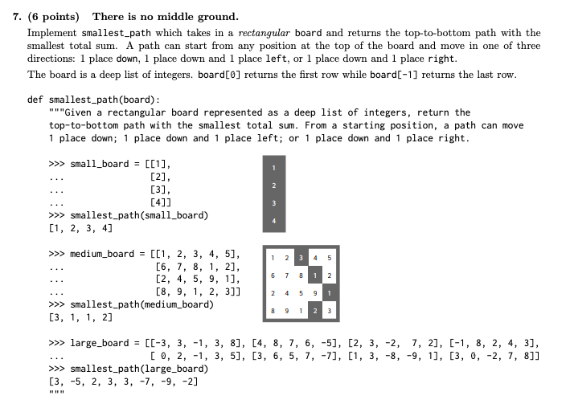
Summer 2017 Final Q7

Slide 17
def smallest_path(board):
left_bound, right_bound = 0, len(board[0])
def path(board, location):
if _____________________________________________________________________:
return _____________________________
elif ___________________________________________________________________:
return [float('inf')] # a board with the value representing infinity
place = board[0][location]
left = _________________________________________________________________ down = _______________________________________________________________
right = ________________________________________________________________
return ________________ + min(____________________________, key=________)
return min(__________________________________________________, key=________)

Slide 18
def smallest_path(board):
left_bound, right_bound = 0, len(board[0])
def path(board, location):
if ___________not board______________________________:
return _______ [ ] _____________
elif ______location < left_bound or location >= right_bound__________:
return [float('inf')] # a board with the value representing infinity
place = board[0][location]
left = __________path(board[1:], location - 1)________________________
down = ________path(board[1:], location)__________________________
right = _________path(board[1:], location + 1)________________________
return ___[place]_____ + min(__left, right, down____, key=__sum__)
return min(____[path(board, i) for i in range(left_bound, right_bound)]____,
key=____sum____)

